Slide 1
CS 106A, Lecture 18 Practice with 1D and 2D Arrays

Slide 2




HW5:
ImageShop
We are here
Practice
2D Arrays
Arrays
Midterm!
The River of Java

Slide 3
Plan for Today
Recap: 2D Arrays and Images
Practice: Shrink
Practice: Cryptogram
Practice: Tic-Tac-Toe

Slide 4
Plan for Today
Recap: 2D Arrays and Images
Practice: Shrink
Practice: Cryptogram
Practice: Tic-Tac-Toe

Slide 5

The Matrix
Image used under “fair use” for educational purposes.
Source: https://www.themarysue.com/decoding-the-transgender-matrix-the-matrix-as-a-transgender-coming-out-story/

Slide 6
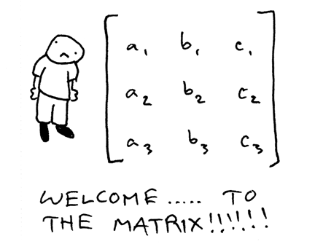
2D Arrays (“Matrices”)

Slide 7
2D Arrays
type[][] name = new type[rows][columns];
int[][] a = new int[3][5];
 | 0 | 1 | 2 | 3 | 4
0 | a[0][0] | a[0][1] | a[0][2] | a[0][3] | a[0][4]
1 | a[1][0] | a[1][1] | a[1][2] | a[1][3] | a[1][4]
2 | a[2][0] | a[2][1] | a[2][2] | a[2][3] | a[2][4]

Slide 8
2D Arrays = Arrays of Arrays!
int[][] a = new int[3][4];
int[] firstRow = a[0];
a[0][0] | a[0][1] | a[0][2] | a[0][3]
a[1][0] | a[1][1] | a[1][2] | a[1][3]
a[2][0] | a[2][1] | a[2][2] | a[2][3]

Slide 9
Summary: 2D Arrays
Make a new 2D array
type[][] name = new type[rows][columns];
Get and set values using bracket notation
name[row][col] // get elem at row,col
name[row][col] = value; // set elem at row,col
Get the number of rows and columns
arr.length // # rows
arr[0].length // # columns
Iterate over a 2D array using a double for-loop
for (int row = 0; row < arr.length; row++) {
for (int col = 0; col < arr[0].length; col++) {
// do something with arr[row][col];
}
}

Slide 10
Limitations of 2D Arrays
Unlike 1D arrays, you cannot compare 2D arrays with Arrays.equals. You must use Arrays.deepEquals.
int[][] a1 = ...
int[][] a2 = ...
if (Arrays.deepEquals(a1, a2)) { ... }
A 2D array does not know how to print itself:
int[][] a = new int[rows][cols];
println(a); // [[I@8cf420
println(Arrays.toString(a)); // [[I@6b3f44,[I@32c2a8]...
// [[0, 1, 2, 3, 4], [1, 2, ...
println(Arrays.deepToString(a));
Notes:
Just like how we can’t do much with chars – but luckily, there are Character methods! Same thing for Arrays.

Slide 11
Images
Images are just grids (2D arrays) of pixels! Pixels are just integer values that have red, green, and blue components (each between 0 and 255).
Notes:
s/o to snowman

Slide 12
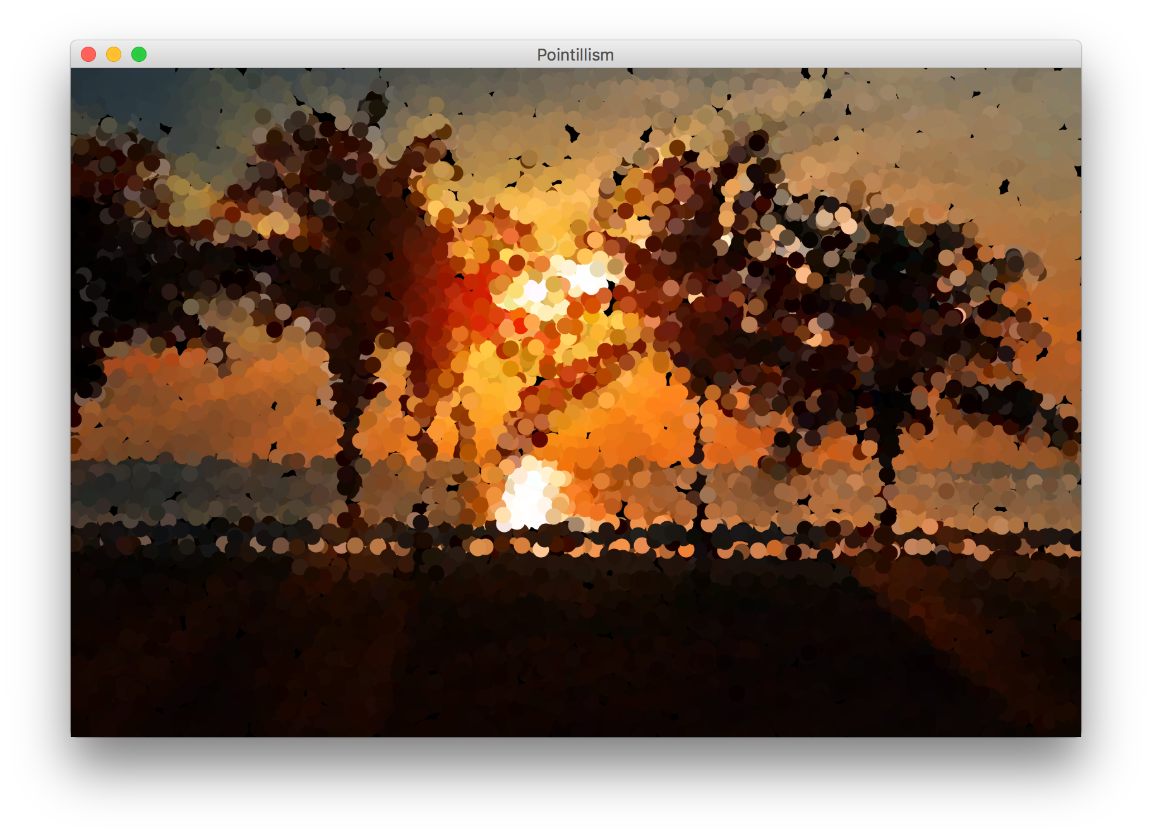

Example: Pointillism
Pointillism is an art style where many small dots of color are combined to make a larger image.

Slide 13
Red, Green and Blue in one int?
Images encode the R, G, and B values (between 0 and 255) of a pixel into a single integer. You can convert between this pixel value and the individual RGB values.
int[][] pixels = image.getPixelArray();
int px = pixels[0][0];
int red = GImage.getRed(px);
int green = GImage.getGreen(px);
int blue = GImage.getBlue(px);

Slide 14
Creating New Pixels
Images encode the R, G, and B values (between 0 and 255) of a pixel into a single integer. You can convert between this pixel value and the individual RGB values.
You can also create pixels with your own RGB values.
int r = ...
int g = ...
int b = ...
int pixel = GImage.createRGBPixel(r, g, b);

Slide 15
Images as 2D Arrays
We can get a GImage as a 2D array of pixels, and modify it any way we want. Then, we can create a new GImage with the modified pixels.
GImage img = new GImage(“res/snowman.jpg”);
int[][] pixels = img.getPixelArray();
... // (modify pixels)
img.setPixelArray(pixels); // update image
// or make a new GImage
GImage newImg = new GImage(pixels);

Slide 16
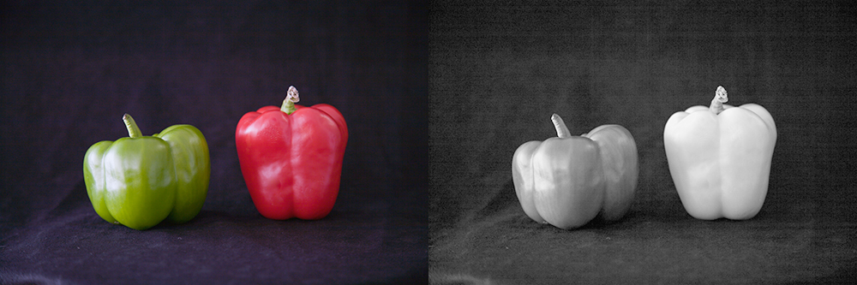
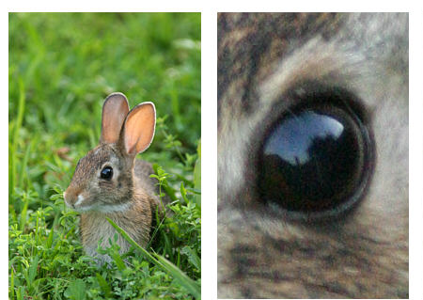
Modifying Image Pixels
There are many cool image algorithms based around modifying individual pixels in an image: grayscale, brighten, normalize, remove red-eye…
grayscale
zoom

Slide 17
GImage Pixel Methods
GImage img = new GImage("res/daisy.jpg");
Method name | Description
img.getPixelArray() | returns pixels as 2D array of ints, where each int in the array contains all 3 of Red, Green, and Blue merged into a single integer
img.setPixelArray(array); | updates pixels using the given 2D array of ints
GImage.createRGBPixel(r, g, b) | returns an int that merges the given amounts of red, green and blue (each 0-255)
GImage.getRed(px) GImage.getGreen(px) GImage.getBlue(px) | returns the redness, greenness, or blueness of the given pixel as an integer from 0-255

Slide 18
Recap: Modifying Pixels
Extract pixel RGB colors with GImage.getRed/Blue/Green.
int red = GImage.getRed(pixels[0][0]); // 0-255
int green = GImage.getGreen(pixels[0][0]); // 0-255
int blue = GImage.getBlue(pixels[0][0]); // 0-255
Modify the color components for a given pixel.
red = 0; // remove redness
Combine the RGB back together into a single int.
pixels[0][0] = GImage.createRGBPixel(red, green, blue);
Update the image with your modified pixels when finished.
image.setPixelArray(pixels);

Slide 19
Plan for Today
Recap: 2D Arrays and Images
Practice: Shrink
Practice: Cryptogram
Practice: Tic-Tac-Toe

Slide 20
Shrink
Let’s write a program that can shrink an image to ½ its original size.

Slide 21
Shrink
Given a pixel (x, y) in our smaller image, how do we know which pixel in our larger image should go there?
Notes:
Going from 16 pixels to 4: there has to be a loss of information there, no way around it

Slide 22
Shrink
Given a pixel (x, y) in our smaller image, how do we know which pixel in our larger image should go there?
Notes:
Ask ourselves as humans which pixels would make most sense

Slide 23
Shrink
Given a pixel (x, y) in our smaller image, how do we know which pixel in our larger image should go there?
(0 , 0) |  | (0, 2)
(2, 0) |  | (2, 2)
(0, 0) | (0, 1)
(1, 0) | (1, 1)
Notes:
Then figure out how to do it in code
Go to next slide, then come back to this for TPS

Slide 24
Shrink
Given a pixel (x, y) in our smaller image, how do we know which pixel in our larger image should go there?

Slide 25
Shrink
int[][] pixels = image.getPixelArray();
int[][] result =
new int[pixels.length/2][pixels[0].length/2];
for (int r = 0; r < result.length; r++) {
for (int c = 0; c < result[0].length; c++) { result[r][c] = pixels[r*2][c*2];
}
}
image.setPixelArray(result);

Slide 26
Shrink
int[][] pixels = image.getPixelArray();
int[][] result =
new int[pixels.length/2][pixels[0].length/2];
for (int r = 0; r < result.length; r++) {
for (int c = 0; c < result[0].length; c++) { result[r][c] = pixels[r*2][c*2];
}
}
image.setPixelArray(result);

Slide 27
Shrink
int[][] pixels = image.getPixelArray();
int[][] result =
new int[pixels.length/2][pixels[0].length/2];
for (int r = 0; r < result.length; r++) {
for (int c = 0; c < result[0].length; c++) { result[r][c] = pixels[r*2][c*2];
}
}
image.setPixelArray(result);

Slide 28
Shrink
int[][] pixels = image.getPixelArray();
int[][] result =
new int[pixels.length/2][pixels[0].length/2];
for (int r = 0; r < result.length; r++) {
for (int c = 0; c < result[0].length; c++) { result[r][c] = pixels[r*2][c*2];
}
}
image.setPixelArray(result);

Slide 29
Shrink
int[][] pixels = image.getPixelArray();
int[][] result =
new int[pixels.length/2][pixels[0].length/2];
for (int r = 0; r < result.length; r++) {
for (int c = 0; c < result[0].length; c++) { result[r][c] = pixels[r*2][c*2];
}
}
image.setPixelArray(result);

Slide 30
Shrink
int[][] pixels = image.getPixelArray();
int[][] result =
new int[pixels.length/2][pixels[0].length/2];
for (int r = 0; r < result.length; r++) {
for (int c = 0; c < result[0].length; c++) { result[r][c] = pixels[r*2][c*2];
}
}
image.setPixelArray(result);

Slide 31
Plan for Today
Recap: 2D Arrays and Images
Practice: Shrink
Practice: Cryptogram
Practice: Tic-Tac-Toe

Slide 32
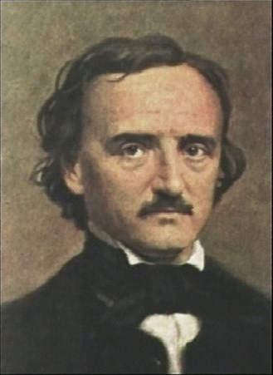
Cryptogram
A cryptogram is a puzzle in which a message is encoded by replacing each letter in the original text with some other letter. Your job in solving a cryptogram is figuring out this substitution pattern.
A common technique is assuming the most common letters in the coded message correspond to the most common letters in English.
Edgar Allan Poe (1809-1849)
Notes:
One of the most famous cryptograms was written by Edgar Allan Poe in his short story “The Gold Bug.”

Slide 33
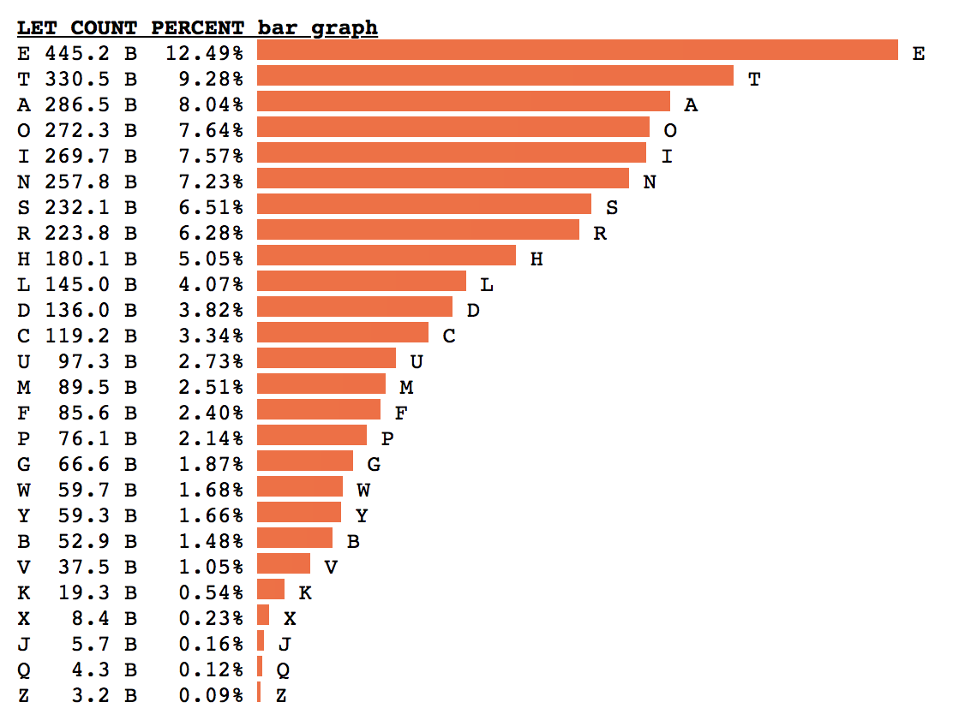
Letter Frequency
By Peter Norvig
Head of Google Research
Former CS221 Instructor
Based on 3.8 trillion letters
Notes:
How does an array help us?

Slide 34
Poe’s Cryptographic Puzzle
5
3
‡
‡
†
3
0
5
)
)
6
*
;
4
8
2
6
)
4
‡
•
)
4
‡
)
;
8
0
6
*
;
4
8
†
8
¶
8
33
6
0
)
)
8
5
;
1
‡
(
;
:
‡
*
8
†
8
3
(
8
8
)
5
*
†
;
4
6
(
;
8
8
*
9
6
*
;
26
?
;
8
)
*
‡
(
;
4
8
5
)
;
5
*
†
2
:
*
‡
(
;
4
9
5
6
*
2
(
5
*
–
4
)
8
¶
4
19
8
*
;
4
0
6
9
2
8
5
)
;
)
6
†
8
)
4
‡
‡
;
1
(
‡
9
;
4
8
0
8
1
;
8
:
8
‡
‡
16
1
;
4
8
†
8
5
;
4
)
4
8
5
†
5
2
8
8
0
6
*
8
1
(
‡
9
;
4
8
;
(
8
8
;
4
(
)
16
*
13
‡
?
3
4
;
4
8
)
4
‡
;
1
6
1
;
:
1
8
8
;
‡
?
;
5
12
6
11
(
10
†
8
1
8
0
6
9
5
5
2
5
5
5
A
3
3
3
G
‡
‡
‡
O
‡
‡
‡
O
†
†
†
D
3
3
3
G
0
0
0
L
5
5
5
A
)
)
)
S
)
)
)
S
6
6
6
I
*
*
*
N
;
;
T
T
4
4
H
H
8
E
E
E
2
2
2
B
6
6
6
I
)
)
)
S
4
4
H
H
‡
‡
‡
O
•
•
•
P
)
)
)
S
4
4
H
H
‡
‡
‡
O
)
)
)
S
;
;
T
T
8
E
E
E
0
0
0
L
6
6
6
I
*
*
*
N
;
;
T
T
4
4
H
H
8
E
E
E
†
†
†
D
8
E
E
E
¶
¶
¶
V
6
:
4
6
6
I
0
0
0
L
)
)
)
S
)
)
)
S
8
E
E
E
5
5
5
A
;
;
T
T
1
1
1
F
‡
‡
‡
O
(
(
(
R
;
;
T
T
:
:
:
Y
‡
‡
‡
O
*
*
*
N
8
E
E
E
†
†
†
D
8
E
E
E
3
3
3
G
(
(
(
R
8
E
E
E
8
E
E
E
)
)
)
S
5
5
5
A
*
*
*
N
†
†
†
D
;
;
T
T
4
4
H
H
6
6
6
I
(
(
(
R
;
;
T
T
8
E
E
E
8
E
E
E
*
*
*
N
9
9
9
M
6
6
6
I
*
*
*
N
?
3
4
?
?
U
;
;
T
T
8
E
E
E
)
)
)
S
*
*
*
N
‡
‡
‡
O
(
(
(
R
;
;
T
T
4
4
H
H
8
E
E
E
5
5
5
A
)
)
)
S
;
;
T
T
5
5
5
A
*
*
*
N
†
†
†
D
2
2
2
B
:
:
:
Y
*
*
*
N
‡
‡
‡
O
(
(
(
R
;
;
T
T
4
4
H
H
9
9
9
M
5
5
5
A
6
6
6
I
*
*
*
N
2
2
2
B
(
(
(
R
5
5
5
A
*
*
*
N
–
–
–
C
4
4
H
H
)
)
)
S
8
E
E
E
¶
¶
¶
V
?
3
8
E
E
E
*
*
*
N
;
;
T
T
4
4
H
H
0
0
0
L
6
6
6
I
9
9
9
M
2
2
2
B
8
E
E
E
5
5
5
A
)
)
)
S
;
;
T
T
)
)
)
S
6
6
6
I
†
†
†
D
8
E
E
E
)
)
)
S
4
4
H
H
‡
‡
‡
O
‡
‡
‡
O
;
;
T
T
1
1
1
F
(
(
(
R
‡
‡
‡
O
9
9
9
M
;
;
T
T
4
4
H
H
8
E
E
E
0
0
0
L
8
E
E
E
1
1
1
F
;
;
T
T
8
E
E
E
:
:
:
Y
8
E
E
E
‡
‡
‡
O
¶
2
1
1
1
F
;
;
T
T
4
4
H
H
8
E
E
E
†
†
†
D
8
E
E
E
5
5
5
A
;
;
T
T
4
4
H
H
)
)
)
S
4
4
H
H
8
E
E
E
5
5
5
A
†
†
†
D
5
5
5
A
2
2
2
B
8
E
E
E
8
E
E
E
0
0
0
L
6
6
6
I
*
*
*
N
8
E
E
E
1
1
1
F
(
(
(
R
‡
‡
‡
O
9
9
9
M
;
;
T
T
4
4
H
H
8
E
E
E
;
;
T
T
(
(
(
R
8
E
E
E
8
E
E
E
;
;
T
T
4
4
H
H
(
(
(
R
–
1
‡
•
1
‡
‡
O
?
?
?
U
3
3
3
G
4
4
H
H
;
;
T
T
4
4
H
H
8
E
E
E
)
)
)
S
4
4
H
H
‡
‡
‡
O
;
;
T
T
1
1
1
F
6
6
6
I
1
1
1
F
;
;
T
T
:
:
:
Y
1
1
1
F
8
E
E
E
8
E
E
E
;
;
T
T
‡
‡
‡
O
?
?
?
U
;
;
T
T
Notes:
How does an array help us?

Slide 35
Poe’s Cryptographic Puzzle
5
3
‡
‡
†
3
0
5
)
)
6
*
;
4
8
2
6
)
4
‡
•
)
4
‡
)
;
8
0
6
*
;
4
8
†
8
¶
8
33
6
0
)
)
8
5
;
1
‡
(
;
:
‡
*
8
†
8
3
(
8
8
)
5
*
†
;
4
6
(
;
8
8
*
9
6
*
;
26
?
;
8
)
*
‡
(
;
4
8
5
)
;
5
*
†
2
:
*
‡
(
;
4
9
5
6
*
2
(
5
*
–
4
)
8
¶
4
19
8
*
;
4
0
6
9
2
8
5
)
;
)
6
†
8
)
4
‡
‡
;
1
(
‡
9
;
4
8
0
8
1
;
8
:
8
‡
‡
16
1
;
4
8
†
8
5
;
4
)
4
8
5
†
5
2
8
8
0
6
*
8
1
(
‡
9
;
4
8
;
(
8
8
;
4
(
)
16
*
13
‡
?
3
4
;
4
8
)
4
‡
;
1
6
1
;
:
1
8
8
;
‡
?
;
5
12
6
11
(
10
†
8
1
8
0
6
9
5
A
G
O
O
D
G
L
A
S
S
I
N
T
H
E
B
I
S
H
O
P
S
H
O
S
T
E
L
I
N
T
H
E
D
E
V
2
5
I
L
S
S
E
A
T
F
O
R
T
Y
O
N
E
D
E
G
R
E
E
S
A
N
D
T
H
I
R
T
E
E
N
M
I
N
:
4
U
T
E
S
N
O
R
T
H
E
A
S
T
A
N
D
B
Y
N
O
R
T
H
M
A
I
N
B
R
A
N
C
H
S
E
V
3
4
?
3
E
N
T
H
L
I
M
B
E
A
S
T
S
I
D
E
S
H
O
O
T
F
R
O
M
T
H
E
L
E
F
T
E
Y
E
O
¶
2
F
T
H
E
D
E
A
T
H
S
H
E
A
D
A
B
E
E
L
I
N
E
F
R
O
M
T
H
E
T
R
E
E
T
H
R
–
1
O
U
G
H
T
H
E
S
H
O
T
F
I
F
T
Y
F
E
E
T
O
U
T
•
1
Notes:
How does an array help us?

Slide 36
Idea: Array of Counters
For problems like this, where we want to keep count of many things, a frequency table (or tally array) can be a clever solution.
Idea: The element at index i will store a counter for the character value ‘A’ + i.
example: count of letter frequency for ”FIDDLE”
letter index | … ... | D 3 | E 4 | F 5 | G 6 | H 7 | I 8 | J 9 | J 10 | L 11 | … …
value |  | 2 | 1 | 1 | 0 | 0 | 1 | 0 | 0 | 1

Slide 37
Plan for Today
Recap: 2D Arrays and Images
Practice: Shrink
Practice: Cryptogram
Practice: Tic-Tac-Toe

Slide 38
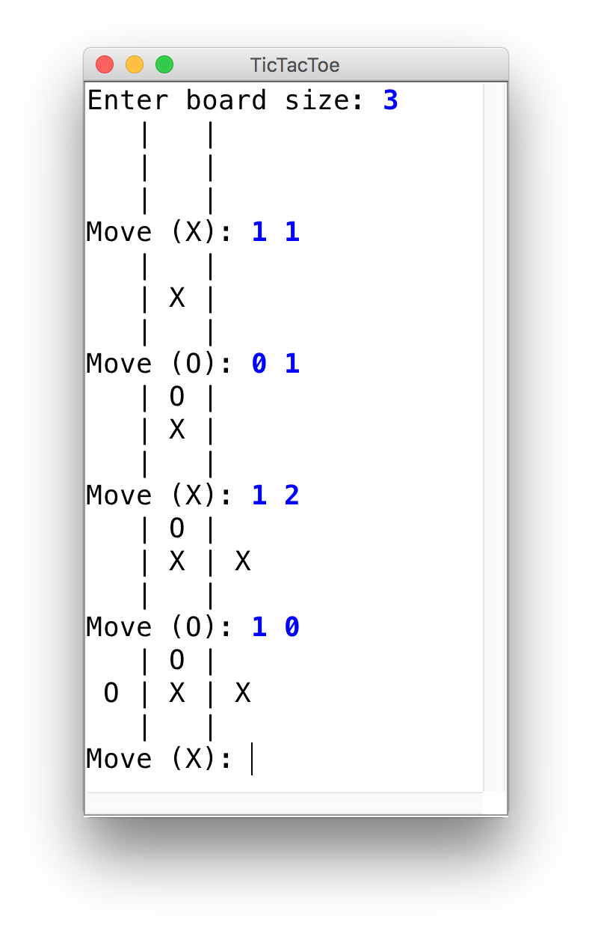
Tic-Tac-Toe
Let’s use 2D arrays to create a ConsoleProgram version of Tic-Tac-Toe.

Slide 39
Recap
Recap: 2D Arrays and Images
Practice: Shrink
Practice: Cryptogram
Practice: Tic-Tac-Toe
Next Time: More data structures

